Slide 1
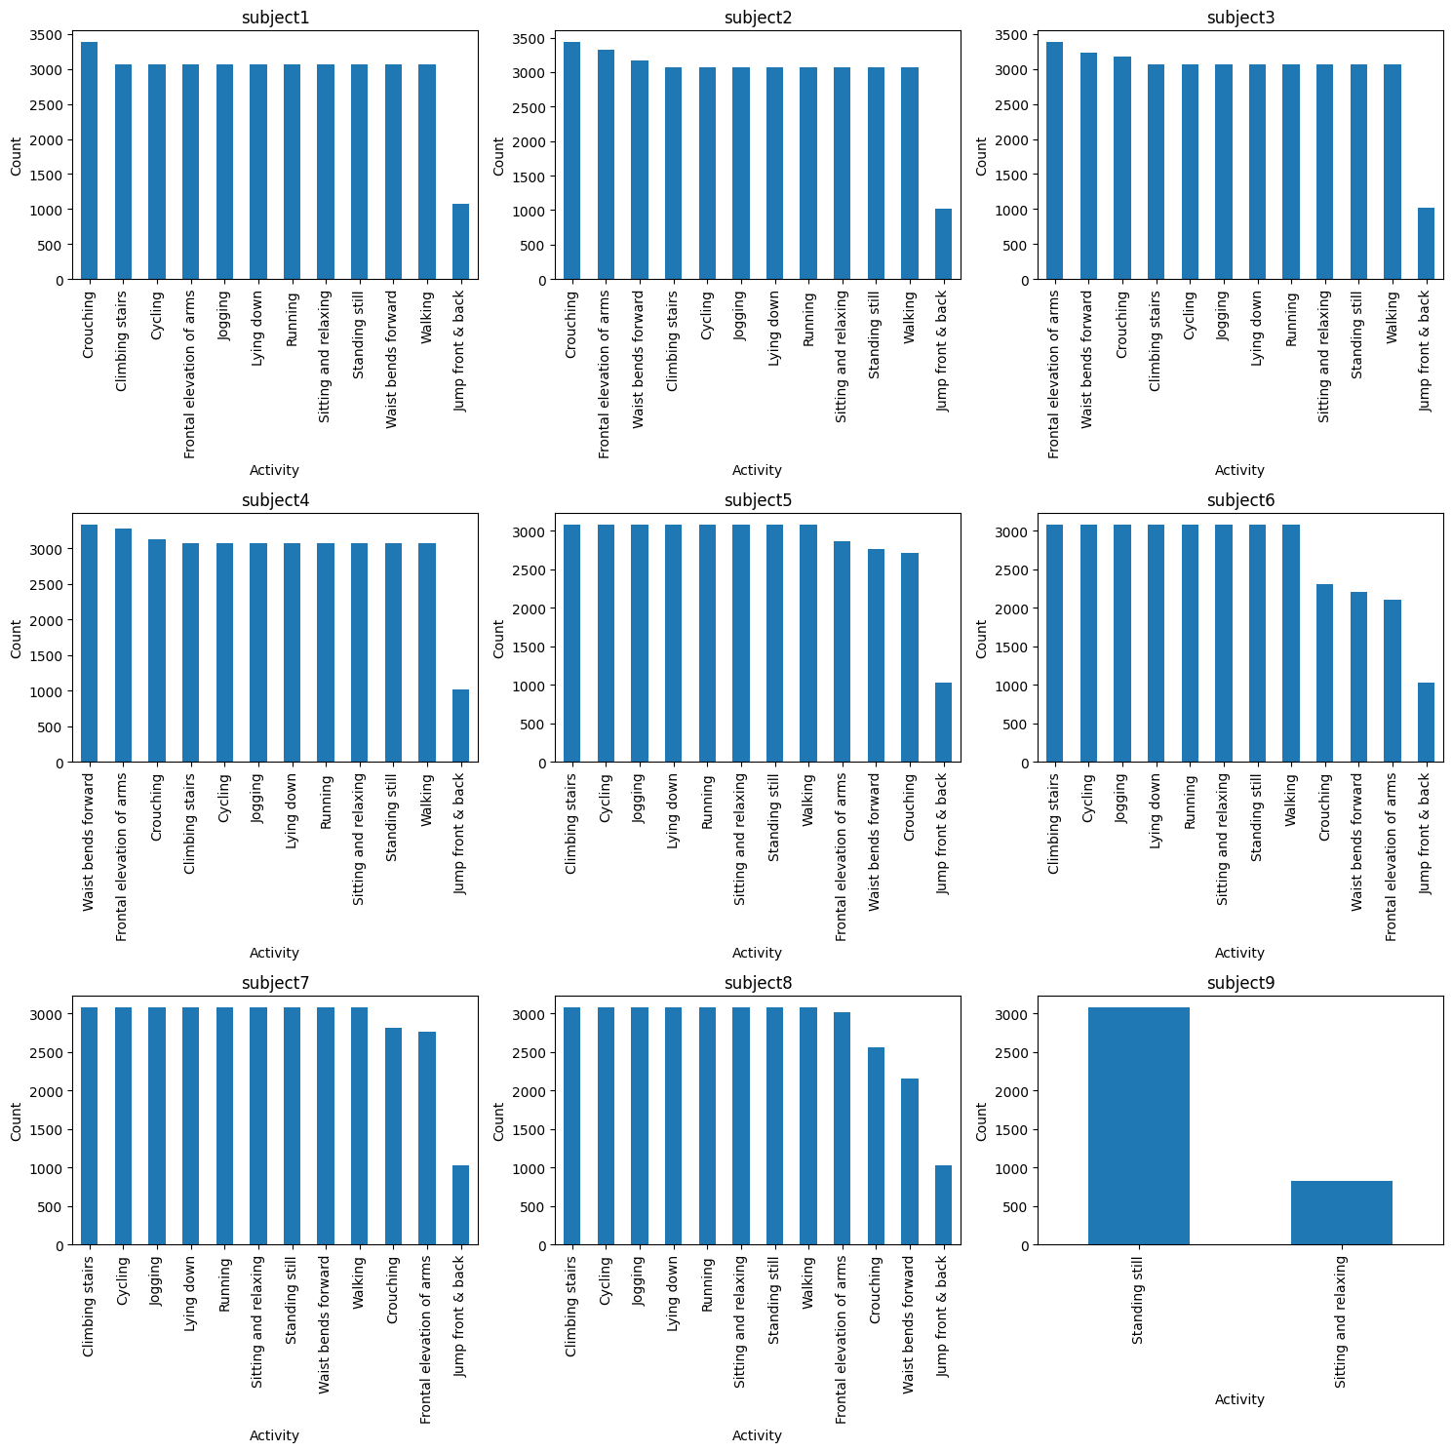
Datathon#5- Team 8
Benjamin Zhang, Xiao Yan, Arij Al Chawaf
Using right-lower-arm sensor data only to predict Activity using Recurrent Neural Networks (RNN) and Long Short-Term Memory (LSTM) models
Feature Engineering
Data Splitting
Normalization
Create sequences
RNN
Class Imbalance
LSTM
Notes:
Feature engineering: dropped Activity (0) and subject 9 + converted subject into numerical using one-hot encoding

Slide 2
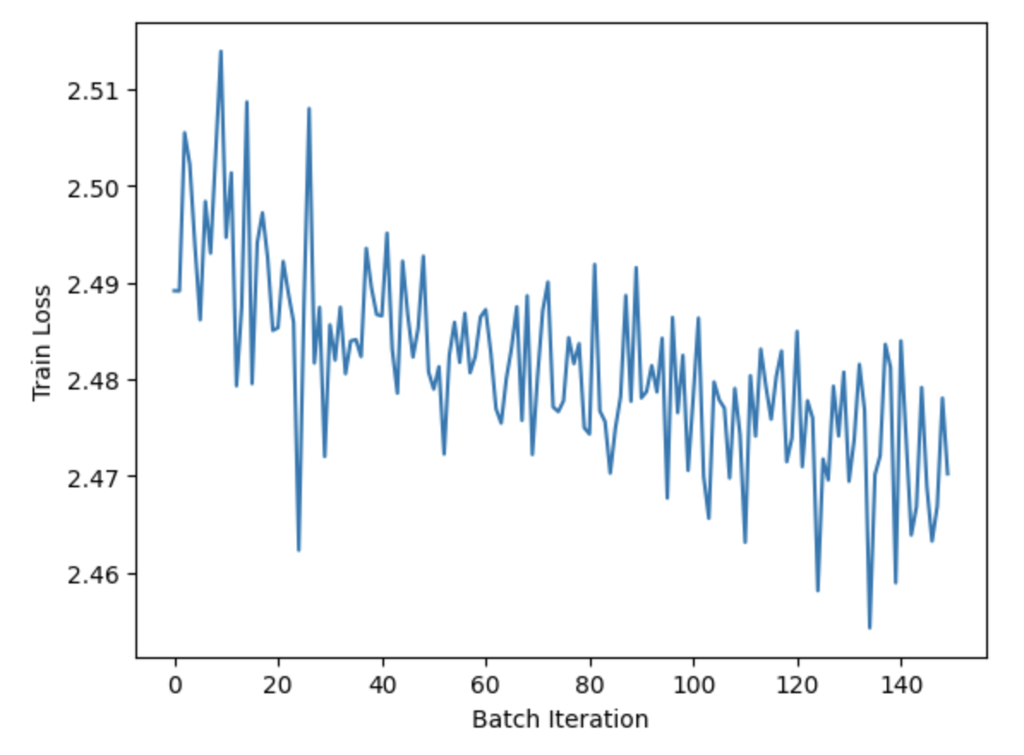
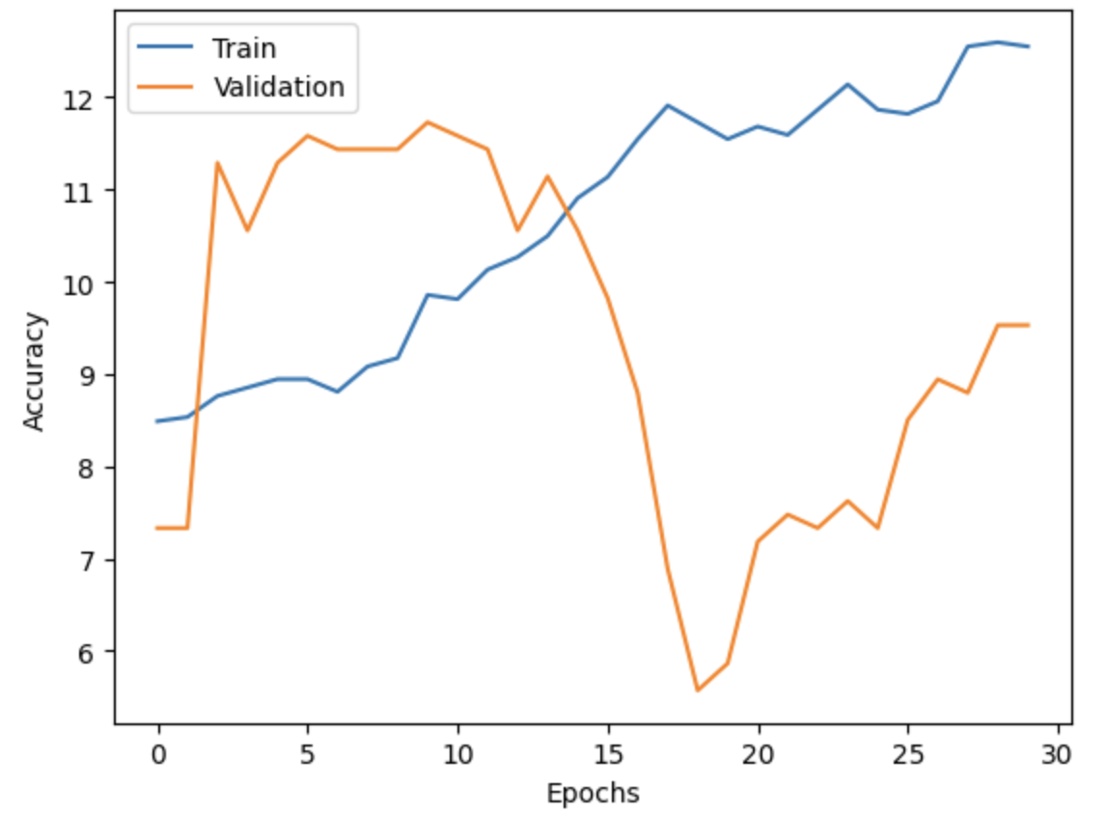
RNN
Hyperparameters
hidden_size = 100 # Number of hidden units in RNN, Careful of the vanishing/exploding gradient problem
num_classes = 12 # For 12-class classification
epochs = 30
learning_rate = 0.0003
batch_size = 300
landa = 0.000001
Activation function = Softmax

Slide 3
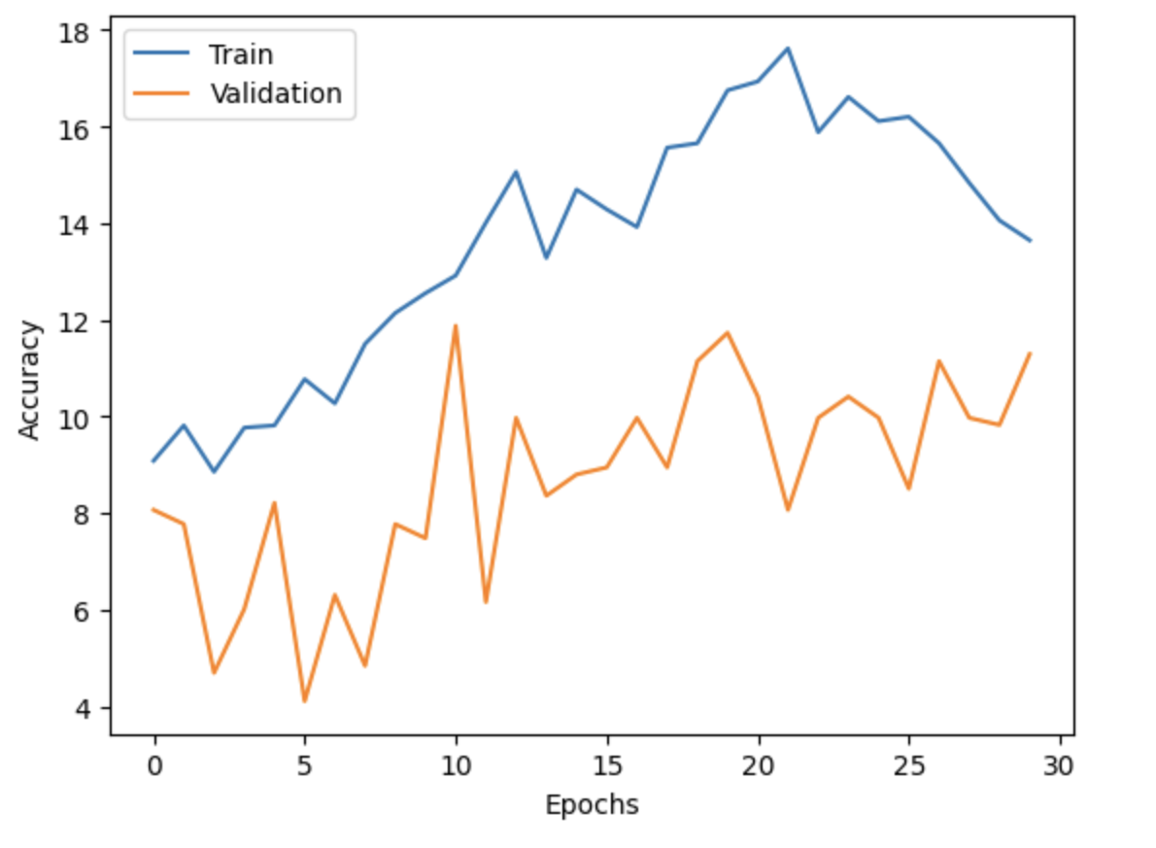
LSTM
Hyperparameters
hidden_size = 100 # Number of hidden units in RNN
num_classes = 12 # For three-class classification
epochs = 30
learning_rate = 0.05
batch_size = 300
landa = 0.001 # Regularization term (lambda)
Activation function = softmax
Findings/Conclusions
On Average, the LSTM model performed slightly better than the RNN model. With greater accuracy on the training dataset without sacrificing accuracy on the validation. However, there seems to be little discriminatory value between these activities.
Issues: model instability

